Slide 1
Forty years ago,
in 1984

Slide 2
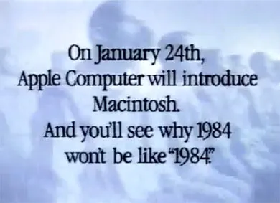
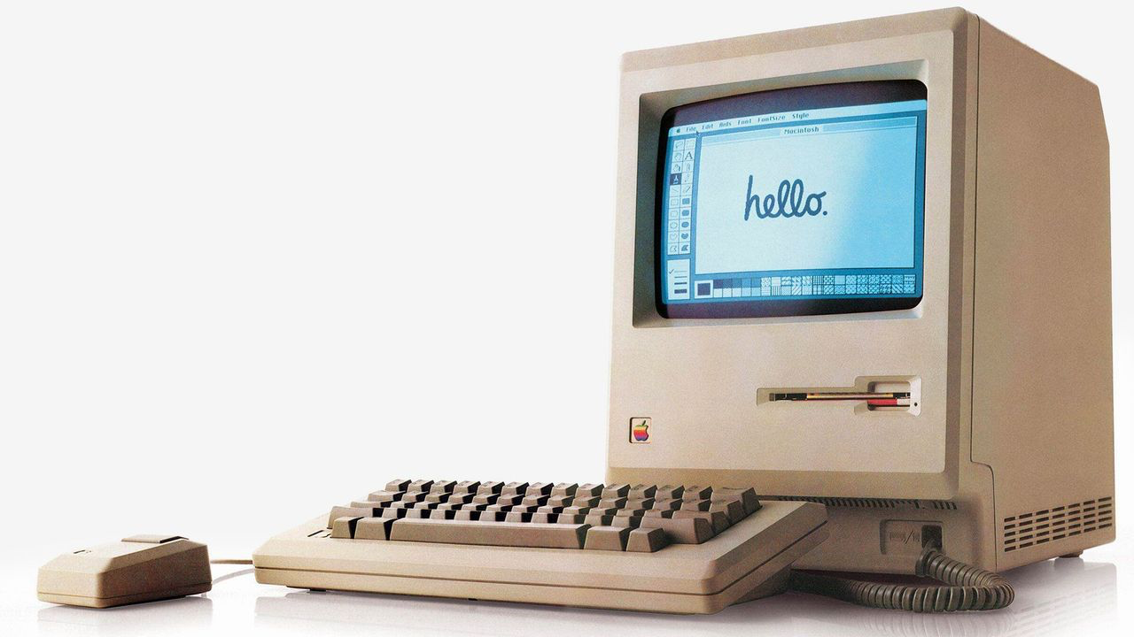
Technology took a huge leap.
Apple launched it’s
first computer advertisement
at Superbowl.
Notes:
Technology took a huge leap. The macbook, Apple we know today launched its first advertisement in Superbowl.

Slide 3
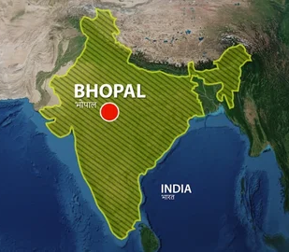
While tech was advancing,
The same year, world’s worst industrial disaster took place in Bhopal, India.

Slide 4
known as The Bhopal Gas Tragedy…

Slide 5
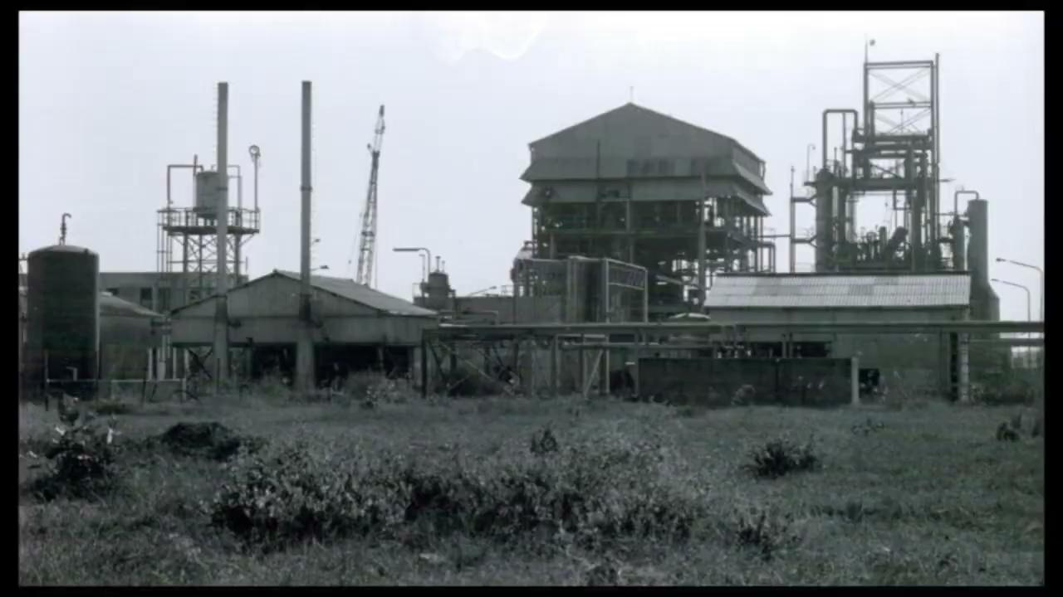
Notes:
On the night of December 2nd, 1984, a catastrophe struck Bhopal, India. Sixty-seven tonnes of the highly toxic gas methyl isocyanate (MIC) leaked from an American-owned pesticide plant, turning a peaceful night into a nightmare. More than half a million people woke up from their sleep and started to run. They scrambled in panic. The scene was one of unimaginable horror: people choking, vomiting, and collapsing in the streets. Some writhed in pain, their eyes burning, while others drowned in their own body fluids. Mothers, gripped by fear, wrapped their babies in blankets and fled. the city shrouded in a deadly cloud of gas and littered with the bodies of the fallen.
By dawn, over 15,000 people had perished.
For the past 40 years, the survivors of the Bhopal Gas Tragedy have been fighting for justice—a fight for the very right to live.

Slide 6
…
Notes:
The American company Union Carbide, now owned by Dow Chemical, bears a significant share of the blame. Reports reveal that Union Carbide was fully aware of 37 critical safety faults at their Bhopal plant. Instead of addressing these faults, they chose to fix similar issues at their West Virginia plant. Despite knowing that storing more than two tonnes of MIC could lead to disaster, they recklessly stored 67 tonnes just one mile from the city center.
The Indian government is also culpable. They overturned zoning laws to allow Union Carbide to store toxic gases and manufacture pesticides in the heart of Bhopal. This decision set the stage for one of the worst industrial disasters in history.
Even more disheartening is the government's response to the tragedy. The plight of the survivors has become a pawn in the political game. When elections approach, politicians visit and make promises, but once the votes are secured, they forget about the pain and suffering of those affected.

Slide 7

1984
2022
Notes:
In 40 years, weight of Apple computer has been significantly reduced

Slide 8
But, what about Bhopal Tragedy?
Notes:
In 40 years, weight of Apple computer has been significantly reduced

Slide 9
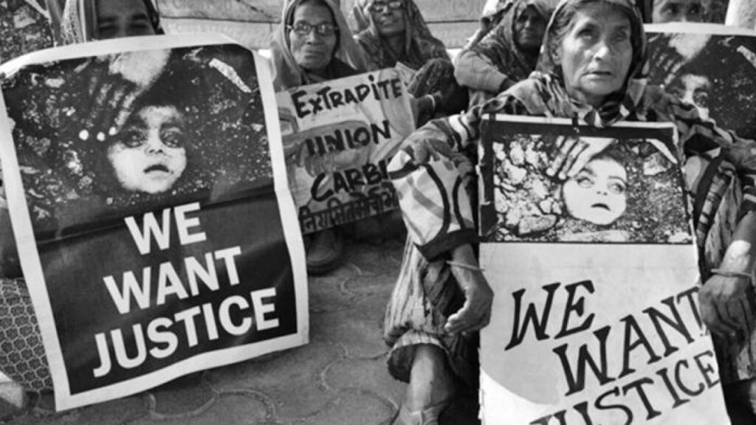
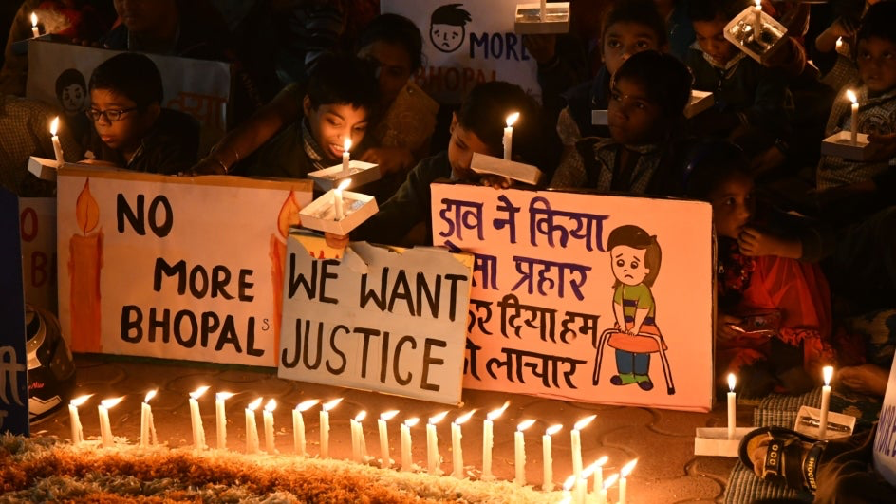
1984
2022
Notes:
Unlike Apple computers Bhopal Gas tragedy did not get better. In Fact it got even worse.
The fight for justice still continues and their sufferings have worsened.

Slide 10
The sufferings worsened.
Notes:
Tragedy took place 40 years ago. And the word tragedy usually signifies something that happened in the past. For example, Bus tragedy killed 89 people. If tragedy is a past event and Bhopal Gas Tragedy happened 40 years ago, then why am I talking about it?

Slide 11

A scenario from 1984, India
Sumit is a 35 year old farmer

Slide 12

A scenario from 1984, India
Sumit is a 35 year old farmer
He lives with his wife, two children and his parents

Slide 13
A scenario from 1984, India
Sumit is a 35 year old farmer
He lives with his wife, two children and his parents
Sumit is the sole earner in his family

Slide 14
A scenario from 1984, India
Sumit is a 35 year old farmer
He lives with his wife, two children and his parents
Sumit is the sole earner in his family
He dreams to educate his children and make them an engineer

Slide 15

The tragedy night
By next month
2nd Dec 1984
1st Jan 1985
Sumit lost his vision and developed respiratory problems.
His old parents died.
Now his wife bears the responsibility of feeding the family and being a caregiver for her husband.
His kids are safe.

Slide 16
Trauma
Lack of healthcare
Economical struggle
No employment
Social discrimination

Slide 17
In this suffering they still had hopes, their children were alright.

Slide 18
In this suffering they still had hopes, their children were alright.
Less than they knew, their children fell sick.

Slide 19
In this suffering they still had hopes, their children were alright.
Less than they knew, their children fell sick.
And Sumit and his wife lost them too.
Notes:
WHY did it happen?

Slide 20
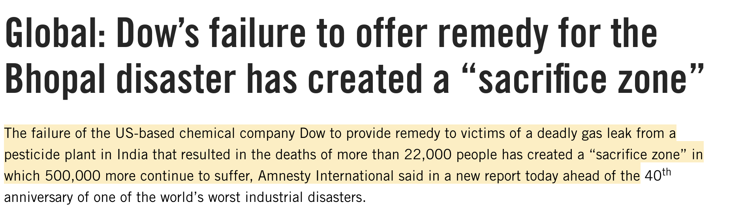
Dow did not clean up.
Dow did not compensate.
Dow did not take accountability.
Since, 1984.
Notes:
It happened because Dow chemical owner of Union Carbide shook off their responsibility of cleaning up.
And never ended up cleaning.

Slide 21
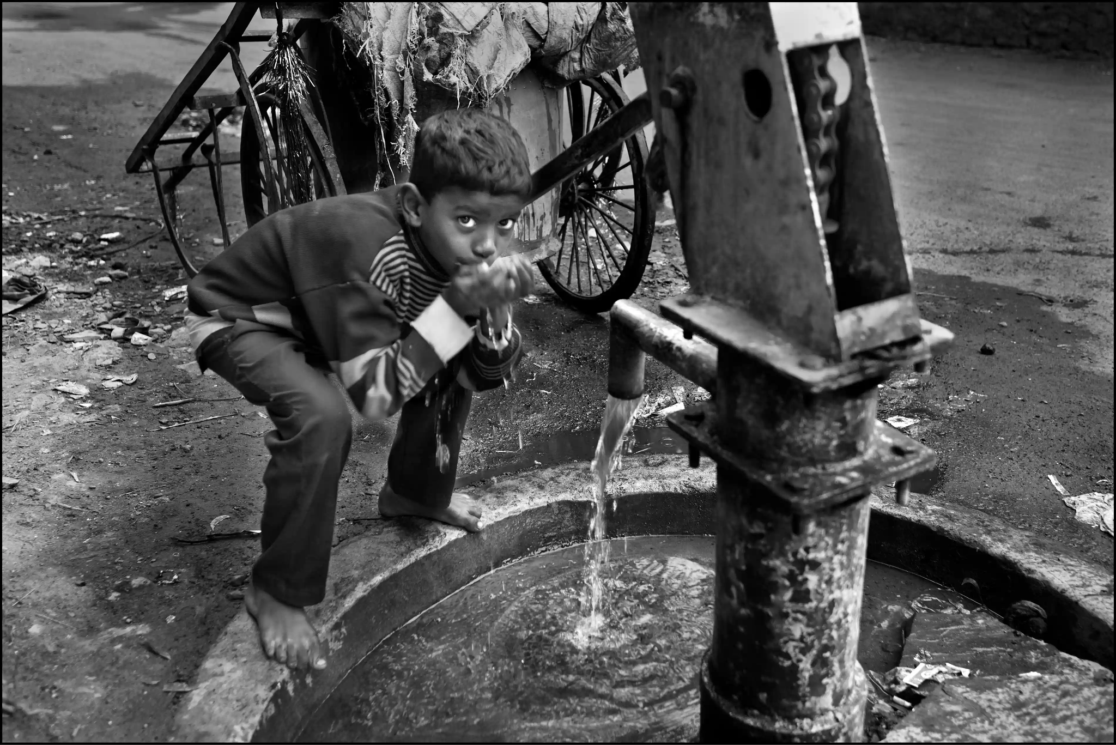
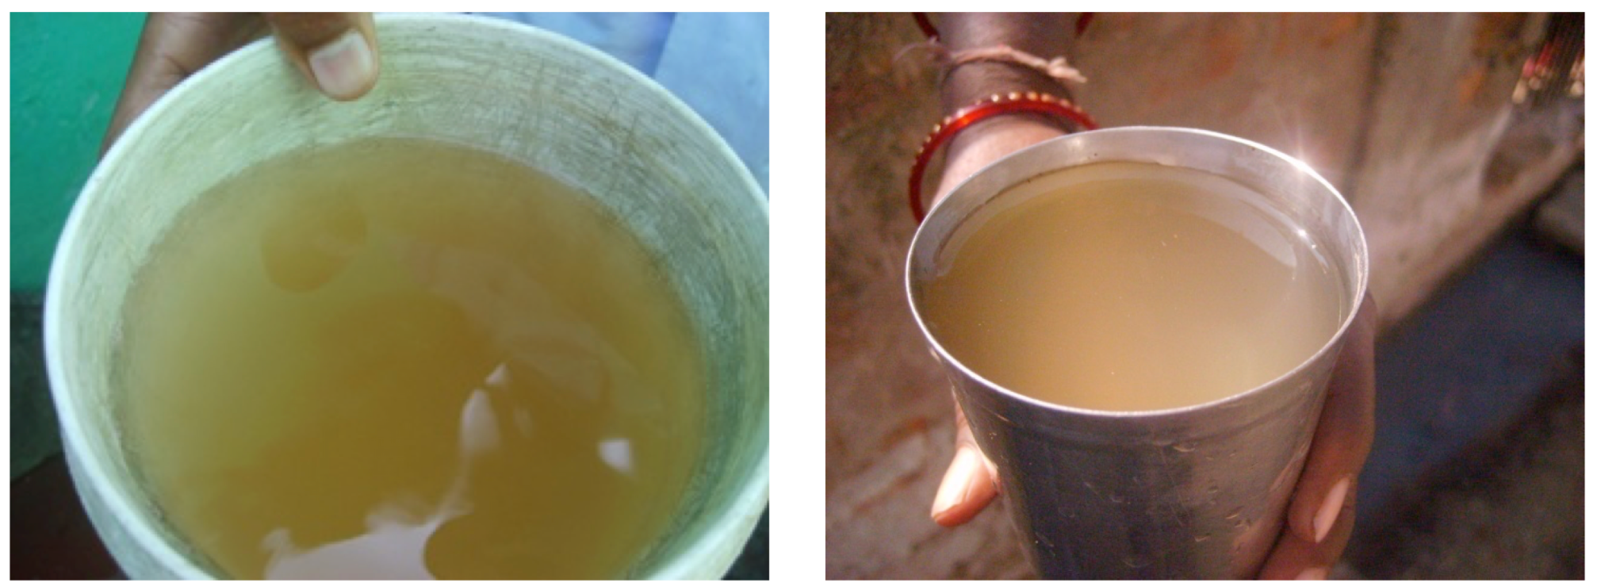
Groundwater is heavily contaminated
It is used for drinking, cooking, farming, for animals
Notes:
Because of which, the toxins remained on the ground for 40 years. These toxins are now present in groundwater. Groundwater is major source of drinking water in India. And for these communities who are already victim of the sufferings have no choice rather than drink this water with heavy contains of mercury and lead.

Slide 22
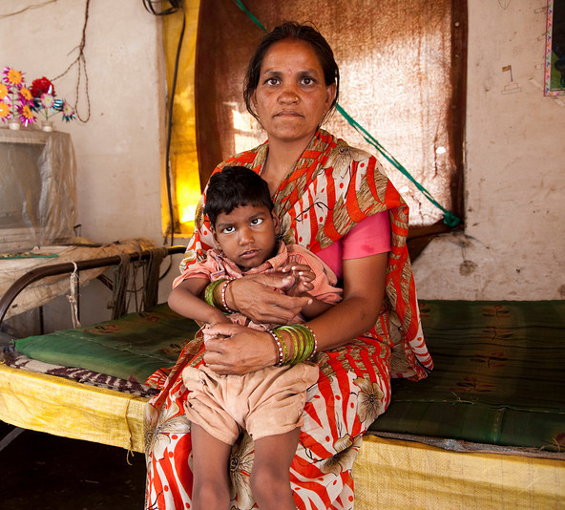
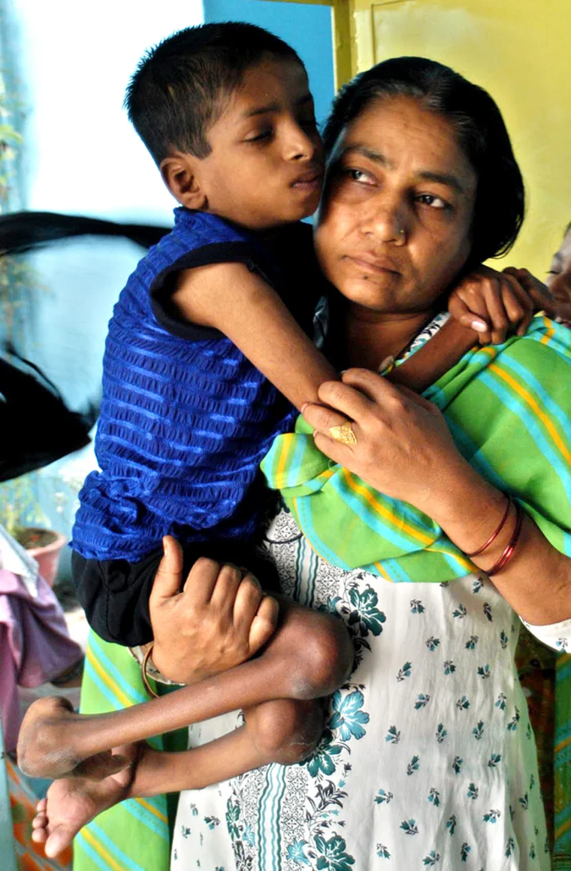
New generation of survivors.
Indirect victims of the disaster
Notes:
The toxins are penetrated so deeply in their bodies that even breast milk contains high level of mercury and lead. DNA of people exposed to the toxic gasses is infected by chemicals resulting in birth defects and neurological disorders in newborn babies.
Destroying the future generations of the survivors.

Slide 23
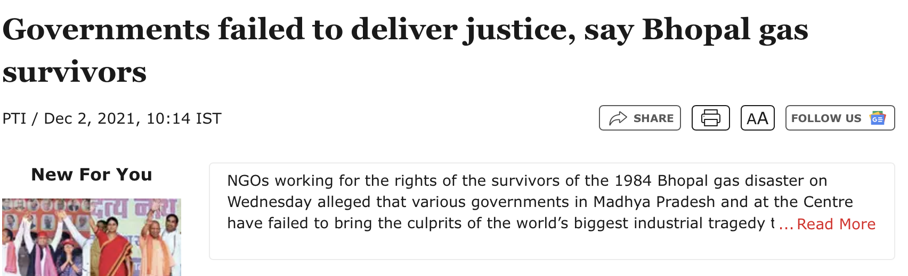
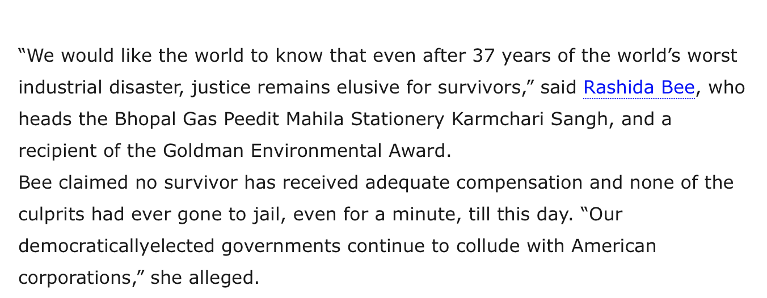
Notes:
While people are suffering, Indian government closed their eyes from it.
Reports tell us that Indian government for its own benefits are siding with the Dow Chemical and is doing nothing to address the suffering of the community.
If not the democratic government, then who will give the justice?

Slide 24
My inquiry
How can we unfold the undocumented impacts of the ongoing tragedy?
Notes:
My inquiry started with reading and researching about this 40 year old tragedy. After spending good amount of time researching, I found similar information on every article. And with 40 years of time, I felt there can be so many undocumented stories and impacts that are unheard, unspoken of.
I started my inquiry on how can we unfold the undocumented impacts and how can I intervene to be a part of this community.

Slide 25
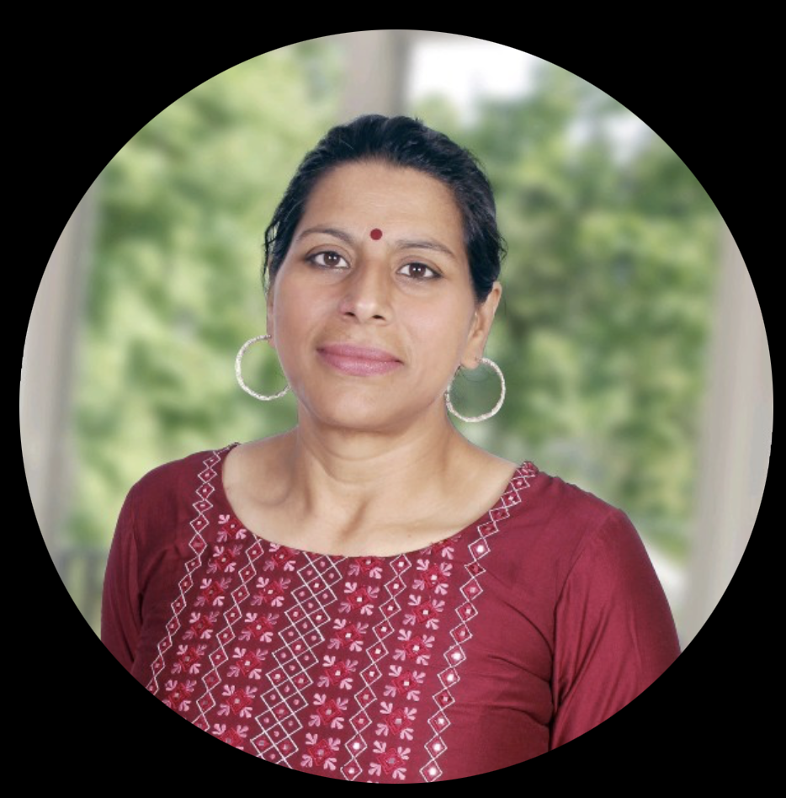

After secondary research,
I had conversation with
Rachna Dhingra
Social Activist
Tulika Bansal
Human Right Consultant

Slide 26
“Corporate Massacre”
90% of survivors and victims are from Marginalized communities:
Lower caste Hindus and Muslims
Rachna Dhingra
Social Activist
80% vacancies in health care centres; inadequate facilities
Extensive advocacy efforts to provide clean drinking water
Forced evictions and power dominance
Notes:
She called it a corporate massacre.
She highlighted that the community demanding and fighting for justice is often considered expendable, as they belong to marginalized groups: lower caste Hindus, Dalits, and minority religion Muslims.
She also pointed out that although hospitals were built for the survivors, 80% of the specialist and doctor positions remain vacant. The hospital buildings exist, but there are no doctors to provide treatment and no facilities available.
She emphasized that the government did provide clean drinking water, but it took a year of extensive advocacy efforts. During this time, she and other protestors were imprisoned.
The latest incident she shared involved the forced eviction of the Muslim community of survivors. A local politician confiscated their identity cards and is stopping them from relocating to a safer and better colony.

Slide 27
Rights that have been violated and continue to be violated in Bhopal:
Right to life
Tulika Bansal
Human Right Consultant
Right to information
Right to education
Right to healthcare
Right to employment

Slide 28
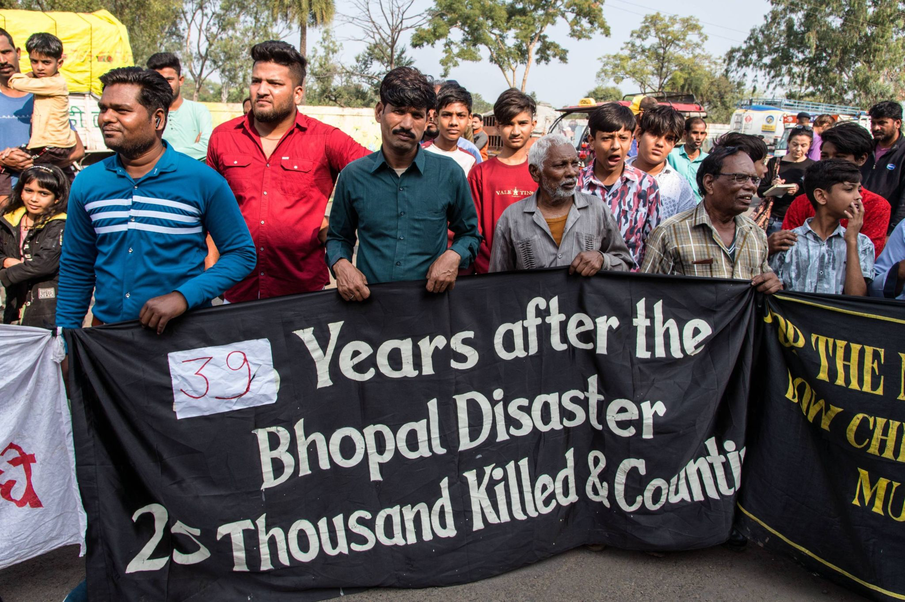
Notes:
While researching, I found this photo. It is very interesting but equally sad.

Slide 29
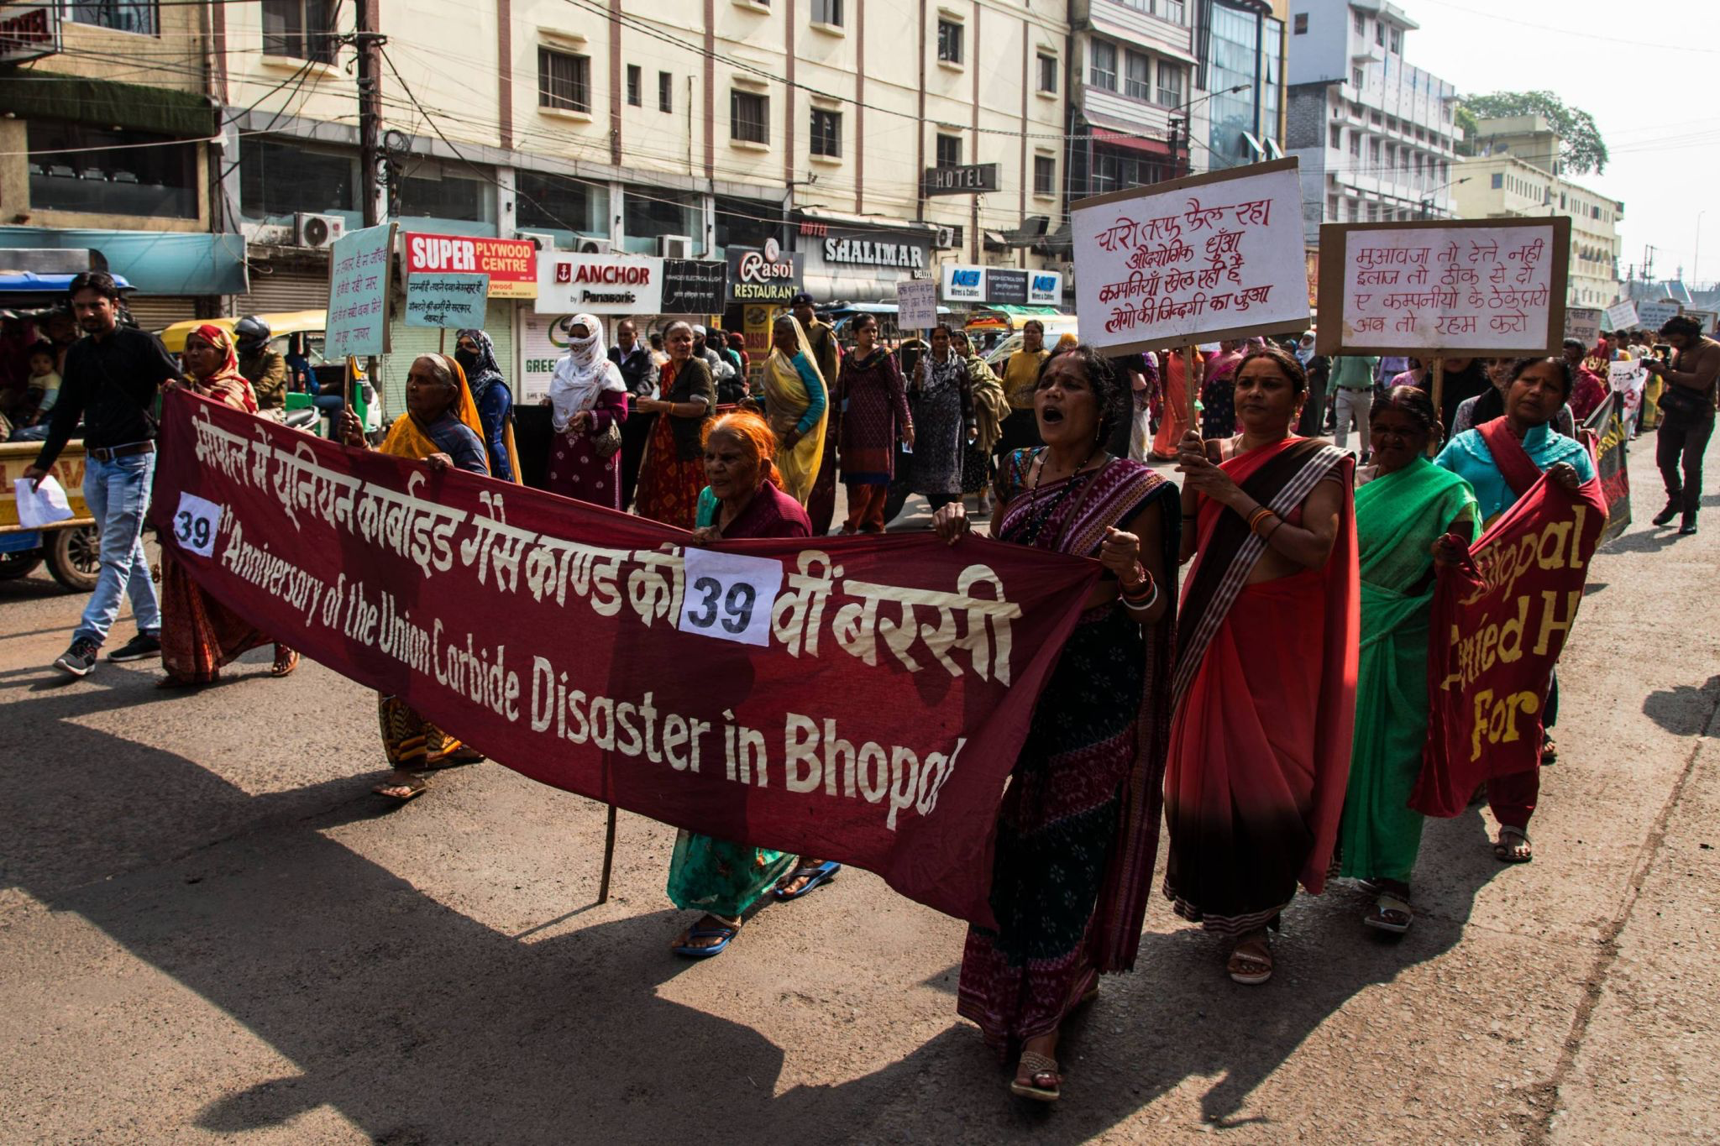
Notes:
These photos are from protest march for 39th Anniversary. From Dec 2023. 6 month ago.
The banner has a additional printed “39” number on it. It left me with multiple questions.
Have we all grown accustomed to this?
Is there any hope that the survivors will ever see justice, or will the number on the banner just keep changing each year?
Who truly cares?
Are people paying attention?
Is Dow Chemical listening? Is the Indian government listening?

Slide 30
It is not just a Tragedy,
Bhopal’s Emergency.
Notes:
The Bhopal gas tragedy is not just a past event; it still breathes today, haunting the lives of survivors and victims. It raises questions about the value of justice, the indifference of society, and the worth of human life. This disaster demands immediate attention and justice.
It is not merely a tragedy; iT IS BHOPAL’S EMERGENCY.

Slide 31
July 2024
Visiting the community
Volunteering in Sambhavna Trust Clinic
Creating a qualitative research tool to understand the perspective and conditions of the survivors and victims on Tragedy
Later August 2024
Hosting the survivor community at The New School
Preparing for Exhibition for 40th Anniversary of Bhopal Gas Tragedy

