Slide 1

Who cares for the environment?
Recycling and Composting in Bogotá
Carlos J. Celis

Slide 2
1 – Research question | Who cares for…
Who cares for the environment in Bogotá?

Slide 3
1 – Research question | Who cares for…
Who cares for the environment in Bogotá?
The care crisis
Climate change

Slide 4
1 – Research question | Who cares for…
Who cares for the environment in Bogotá?
Climate change

Slide 5
1 – Research question | Justification
Bogotá produces 7,945 tons of trash daily ¹
Climate change
¹ Special Administrative Office of Public Services of Bogotá (2021).

Slide 6
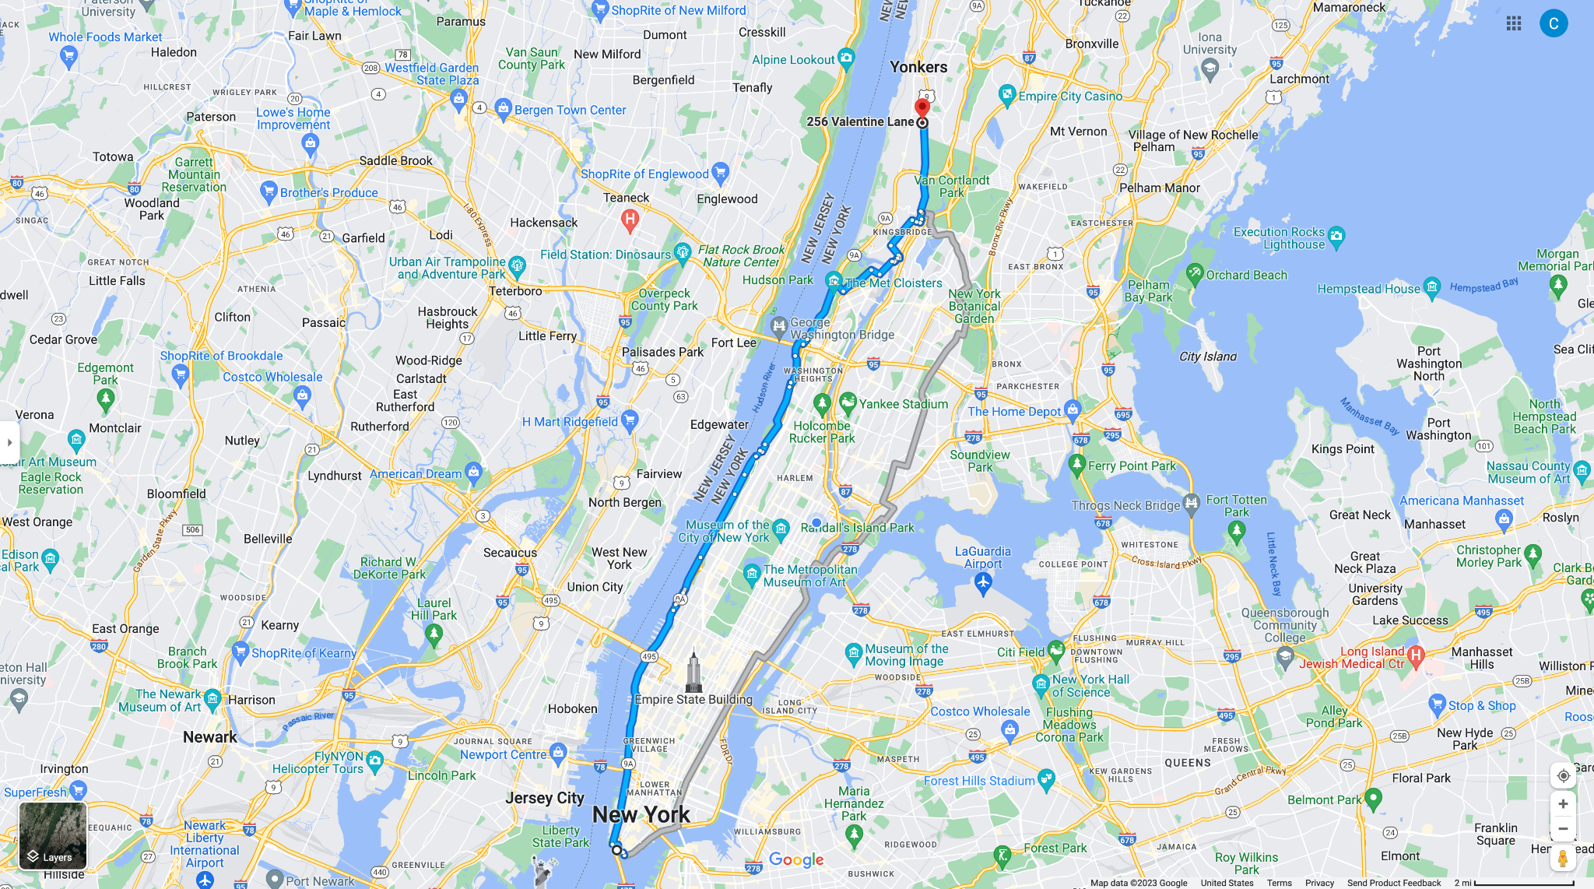
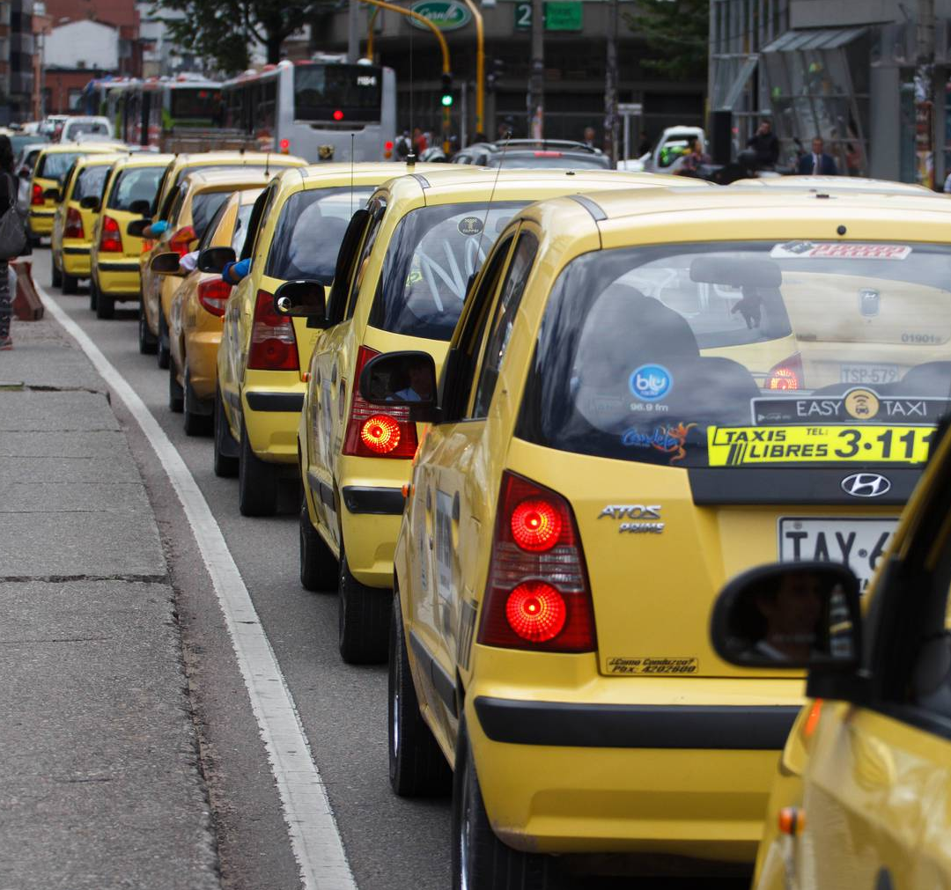

Slide 7
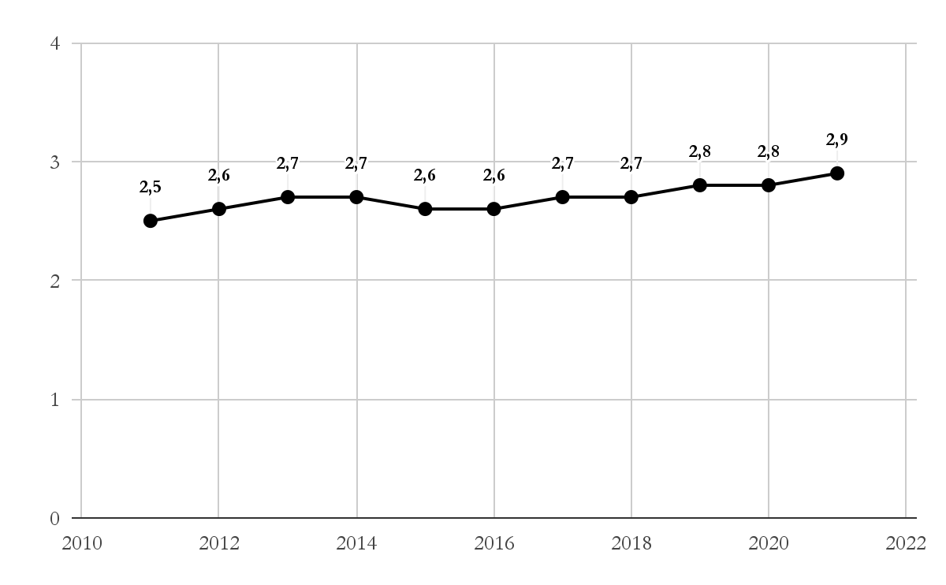
1 – Research question | Justification
Yearly waste production in Bogotá (2011-2021).
Millions of tons
Year
Source: Special Administrative Office of Public Services of Bogotá (2021).

Slide 8
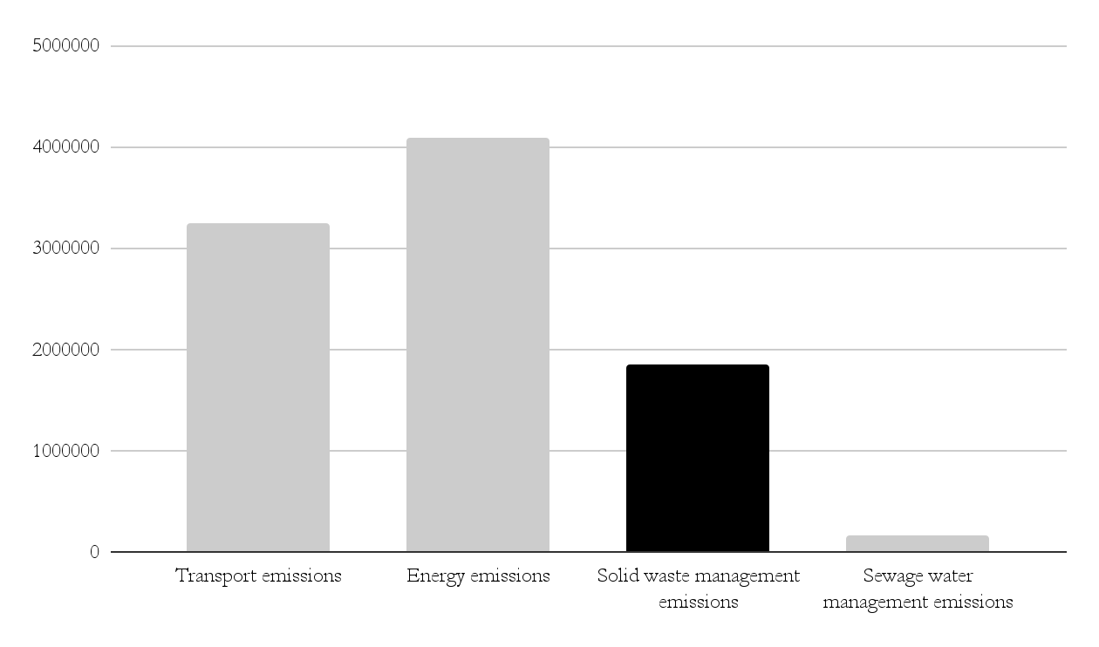
1 – Research question | Justification
Greenhouse gas emissions in Bogotá (2020).
GHGs, Ton CO2 eq
Source
Source: Bogotá’s Environmental Affairs Office (2020).

Slide 9
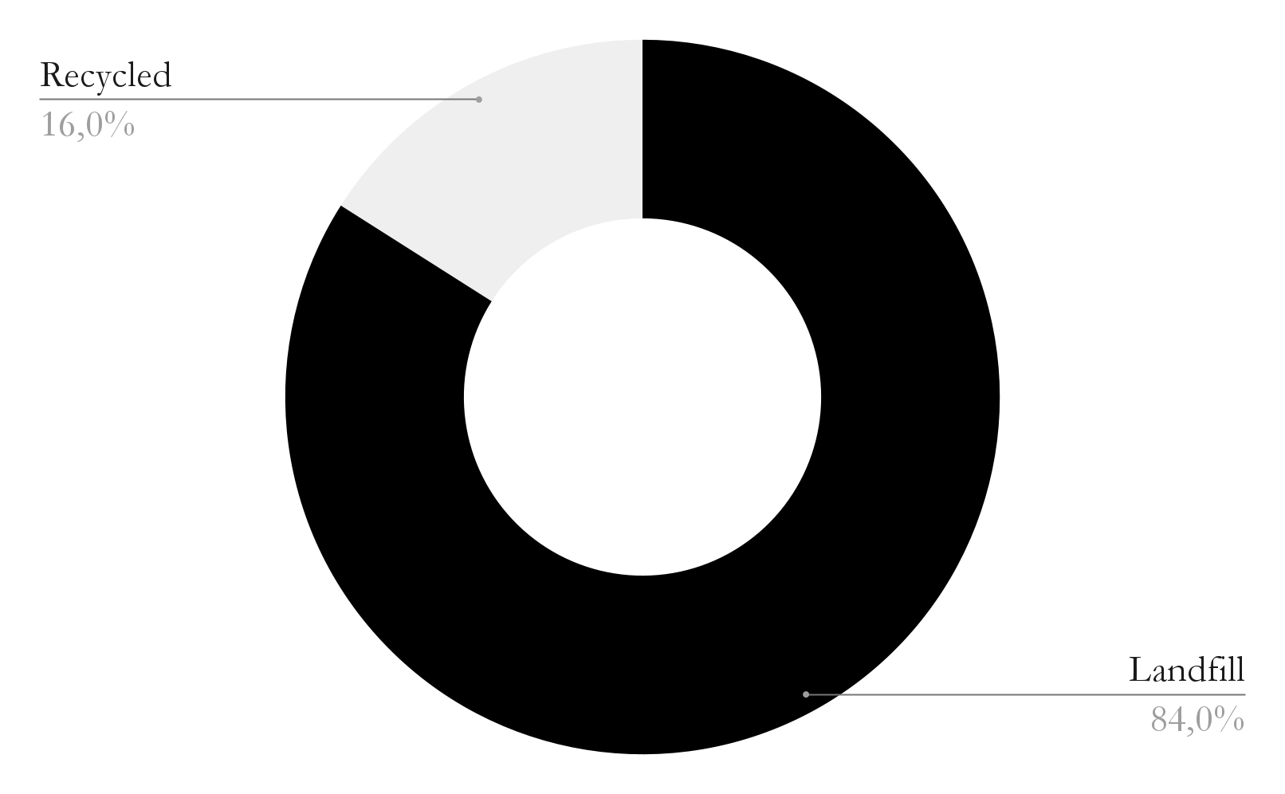
1 – Research question | Justification
Waste management in Bogotá
Source: Special Administrative Office of Public Services of Bogotá (2017).

Slide 10
1 – Research question | Who cares for…
Who cares for the environment in Bogotá?

Slide 11
1 – Research question | Justification
30,500 informal waste pickers ²
Care crisis
² Florez (2022).

Slide 12
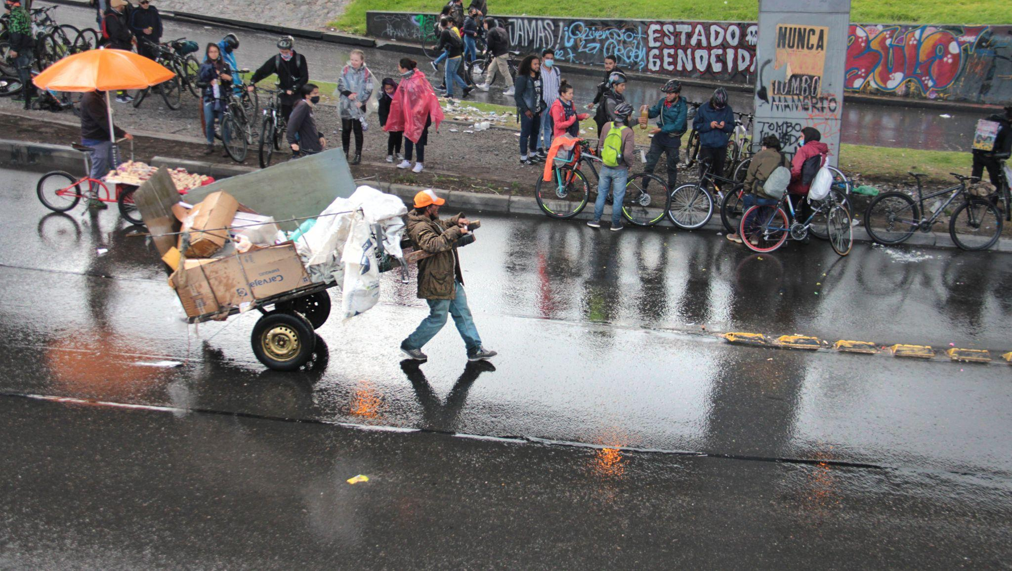

Slide 13
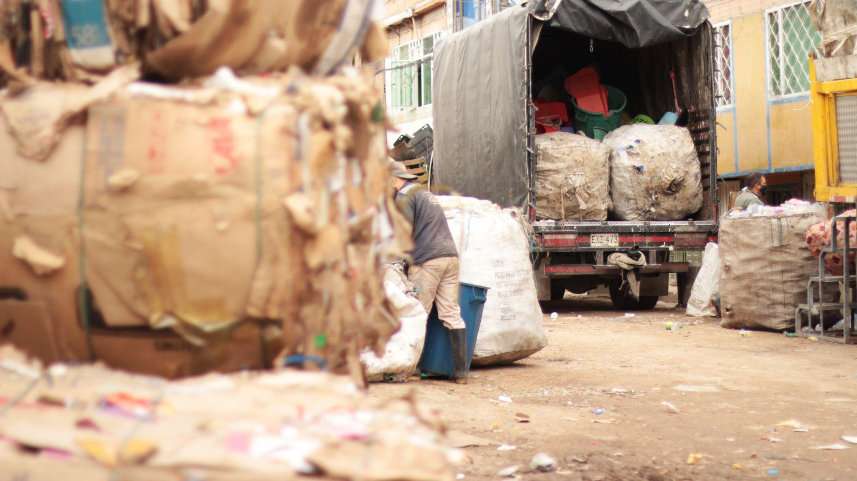

Slide 14
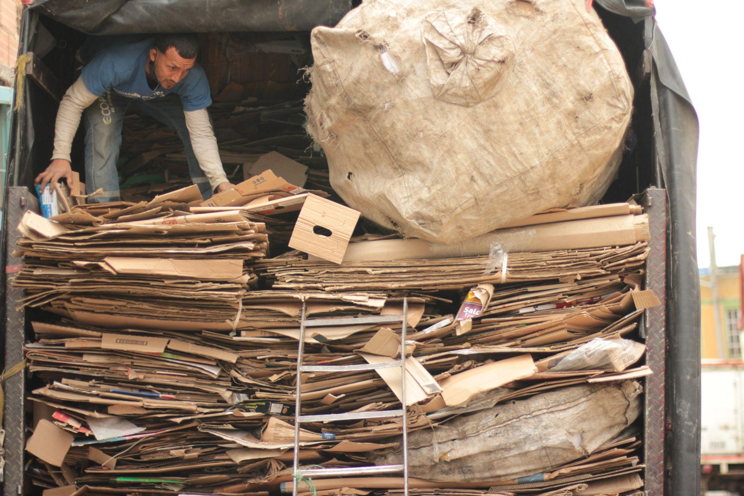

Slide 15
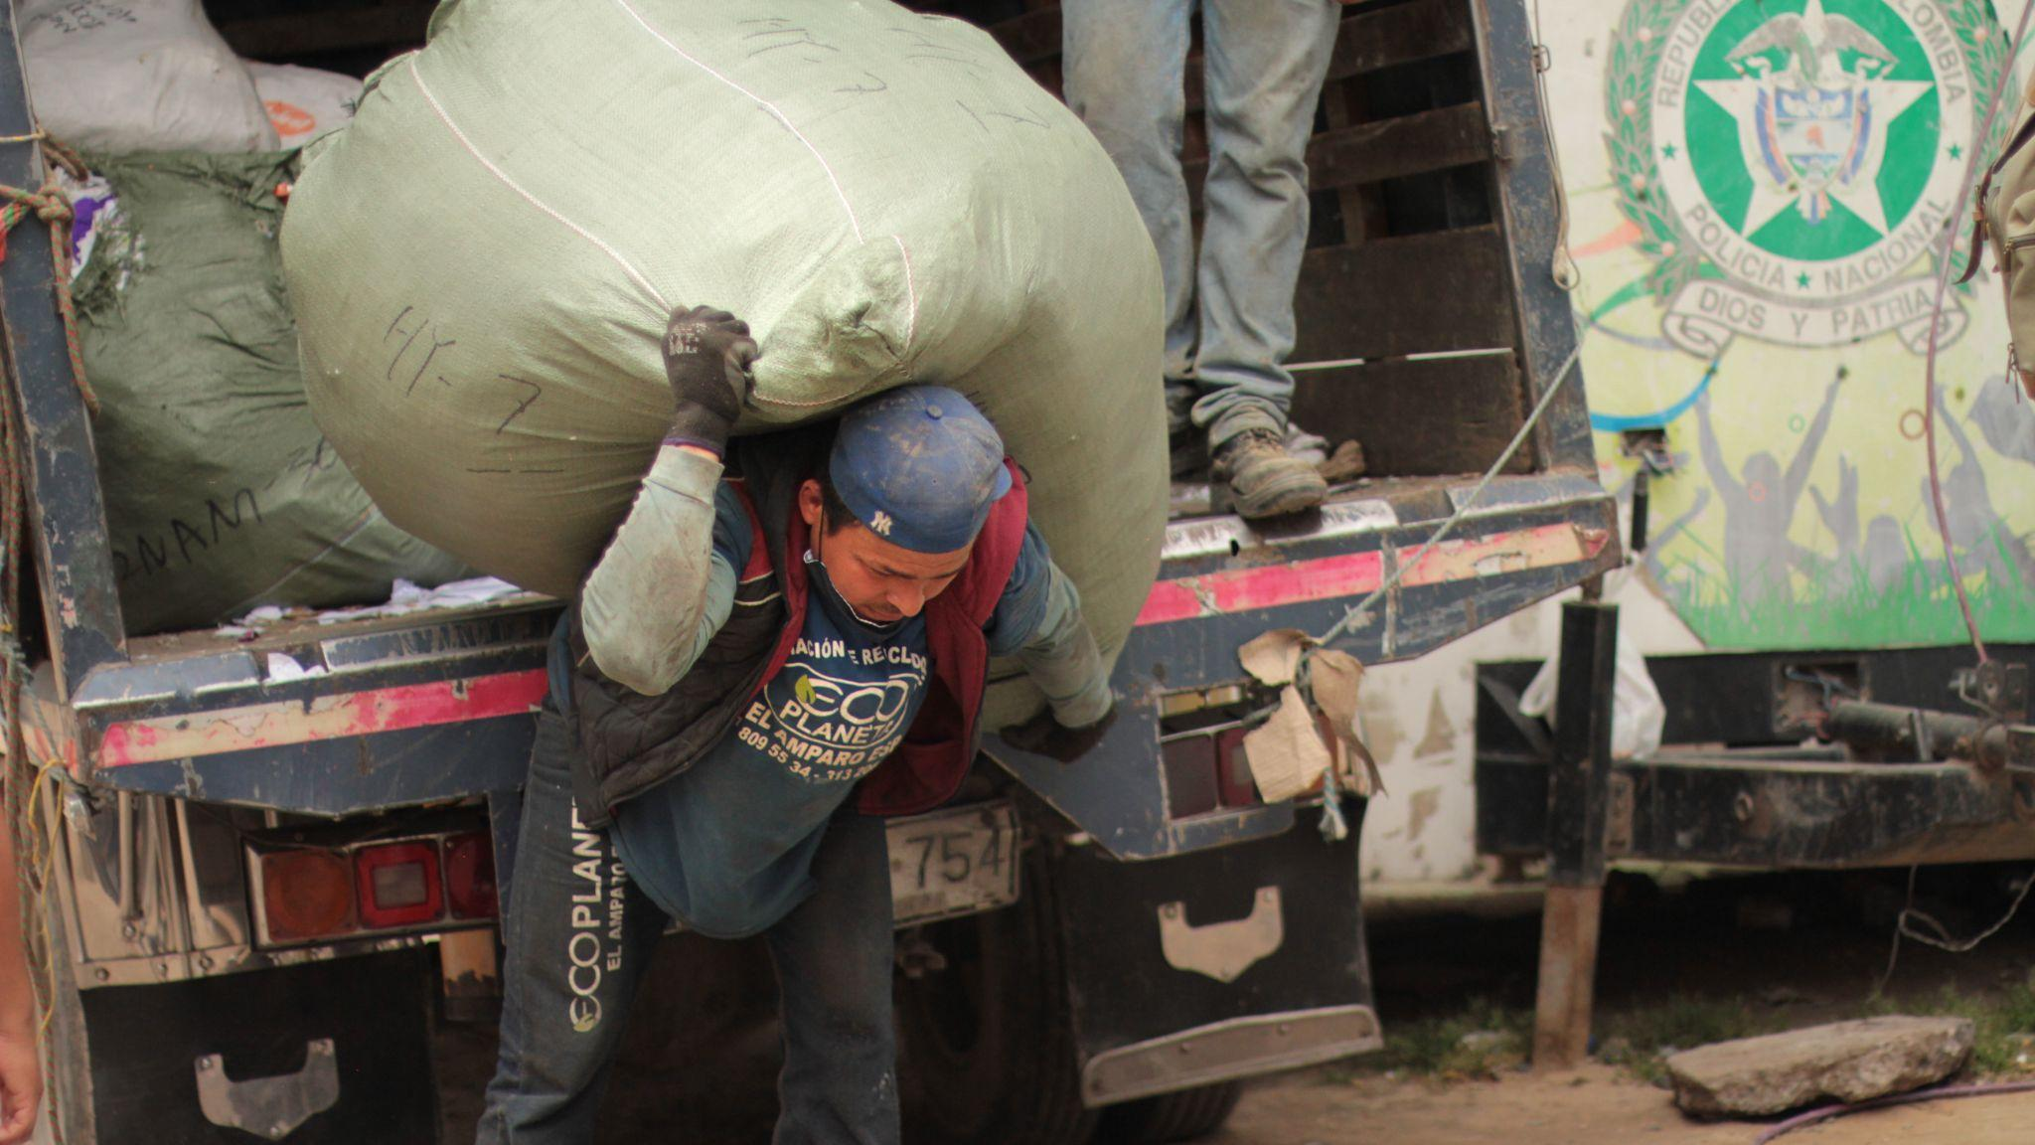

Slide 16
1 – Research question | Who cares for…
Who cares for the environment in Bogotá?
The care crisis

Slide 17
1 – Research question | Justification
“The majority do not have personal protection elements to carry out their work, they are not affiliated with the social security system that protects them against the various contingencies that may arise, and sometimes they must work much more than 8 hours a day” ³
Care crisis
³ Orduz (2022).

Slide 18
1 – Research question | Justification
(1) increasing demand for care ⁴ (2) a global economic model that systematically “free-rides” ⁵ care labor or underpays it ⁶; (3) enormous inequities in terms of who assumes this type of labor. ⁷
Care crisis
⁴ Dowling (2020), ⁵ Fraser (2016), ⁶ Folbre & Smith (2017), ⁷ Federici (2012).

Slide 19
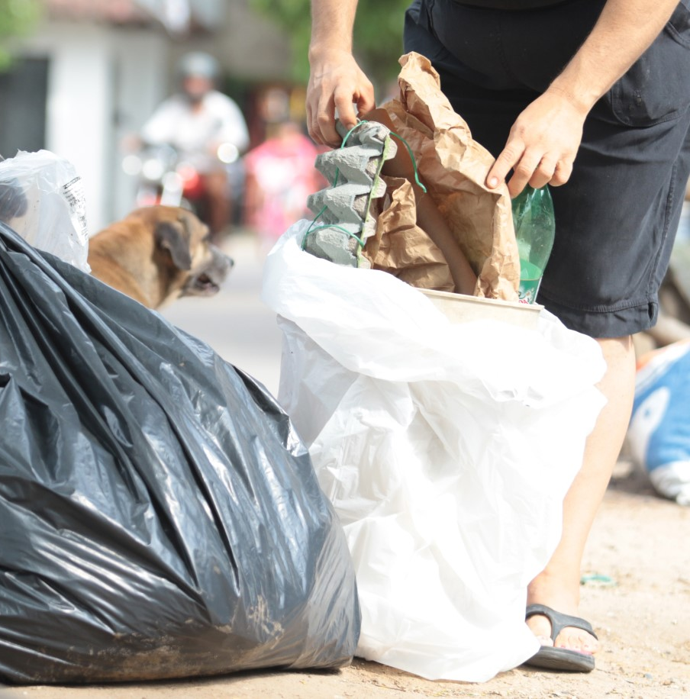

1 – Research question | Who cares for…
Landfill
Waste
Consume
Recycle II
Collection
In the Streets
Recycle I
Separation
in Households and street.

Slide 20

3 – Methods | Data set
Statistically representative citywide, 2200 observations, 2% margin of error, and 95% confidence interval.
Source: Bogotá’s Cultural Affairs Office (2021).

Slide 21
2 – Literature review | COM-B Model
Capability
physical
psychologic
Motivation
Behavior
automatic
reflexive
Opportunity
physical
social
Source: West & Michie (2020).

Slide 22
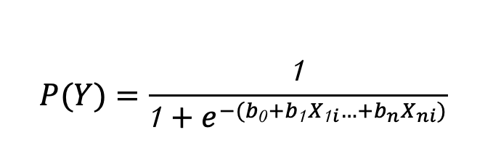
3 – Methods | Logistic regression
(Y₁) Recycling
(Y₂) Composting
(X) Factors
(Step 1) Following the literature review, selected the factors, (Step 2) cross tables and Chi2; (Step 3) Logistic regression.
Adaptation from Field et al., 2012, p. 314

Slide 23
3 – Methods | Factors
recycle
compost
(1) female, (2) no prejudices, (3) senior,
(4) belief_impact, (5) lvl_4, (6) animals,
(7) university.
predict
Dependent variable
Independent variables (factors)

Slide 24
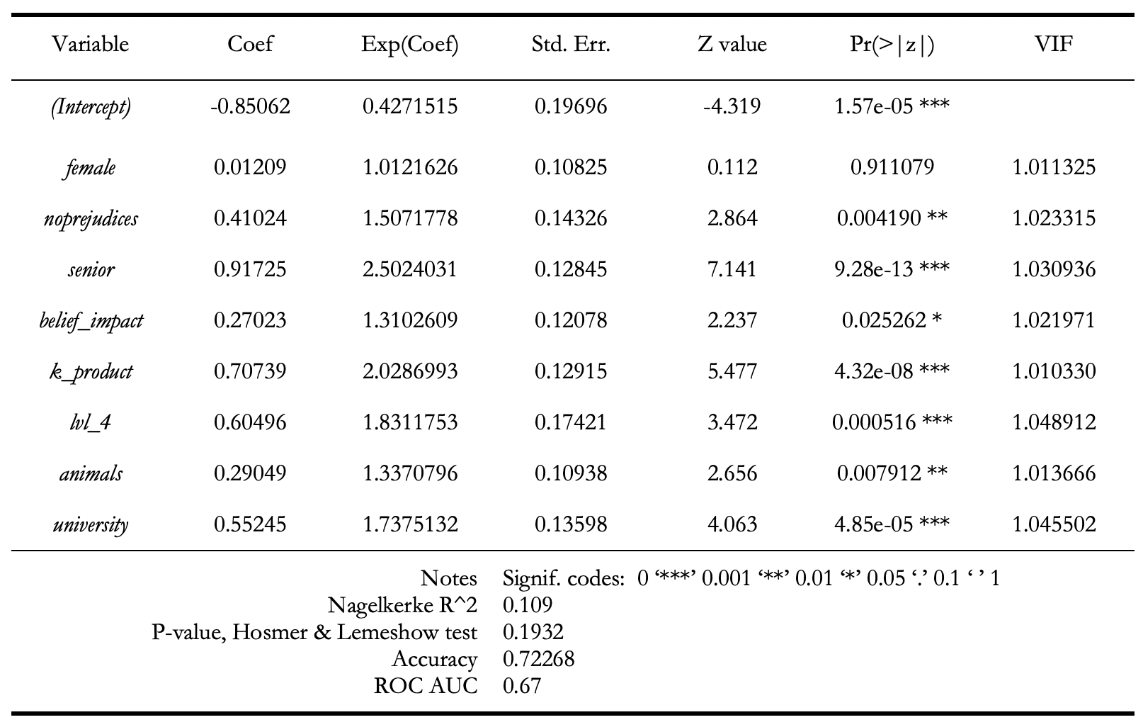
4 – Results | Regression recycling

Slide 25
4 – Results | Regression recycling

Slide 26
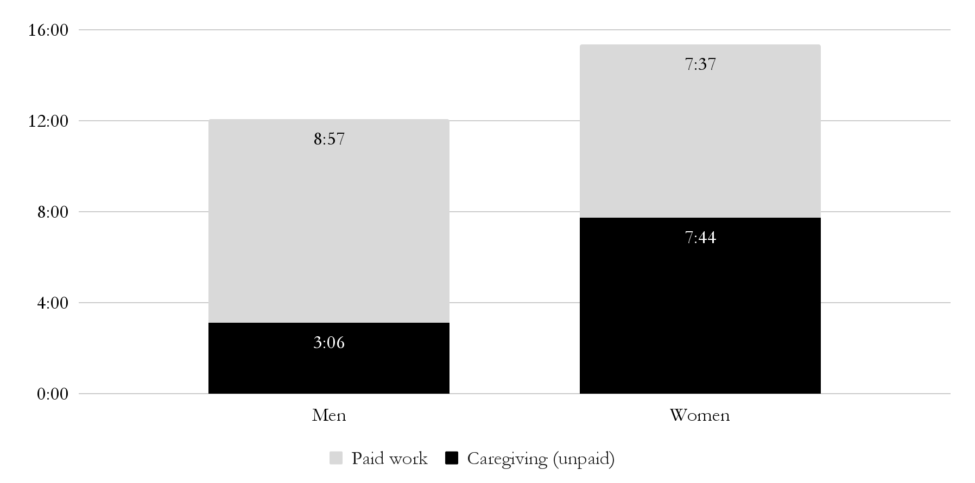
4 – Results | Regression recycling
Daily time in caregiving activities per participant (Colombia 2020-2021).
Hours
Average age for direct care is 33 years old
Source: National Survey of Use of Time, DANE (2020).

Slide 27
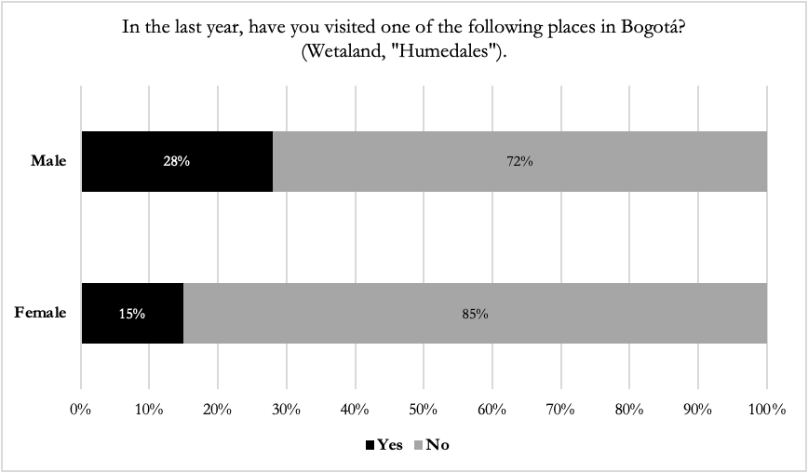
4 – Results | Regression recycling
Source: Executive Document Environmental Culture Survey (2021).

Slide 28



4 – Results | Regression recycling

Slide 29
4 – Results | Regression recycling

Slide 31
4 – Results | Regression recycling

Slide 32
4 – Results | Regression recycling

Slide 33
4 – Results | Regression recycling

Slide 34
4 – Results | Regression recycling

Slide 35
4 – Results | Regression recycling

Slide 36
4 – Results | Regression recycling
people living with animals are 1.3 more likely to recycle
Independent variable

Slide 37
4 – Results | Regression recycling
“companion species [for instance, dogs and humans] infect each other all the time…for good and for ill. Bodily ethical and political obligations are infectious, or they should be”
Donna Haraway (2016, p. 29)

Slide 38
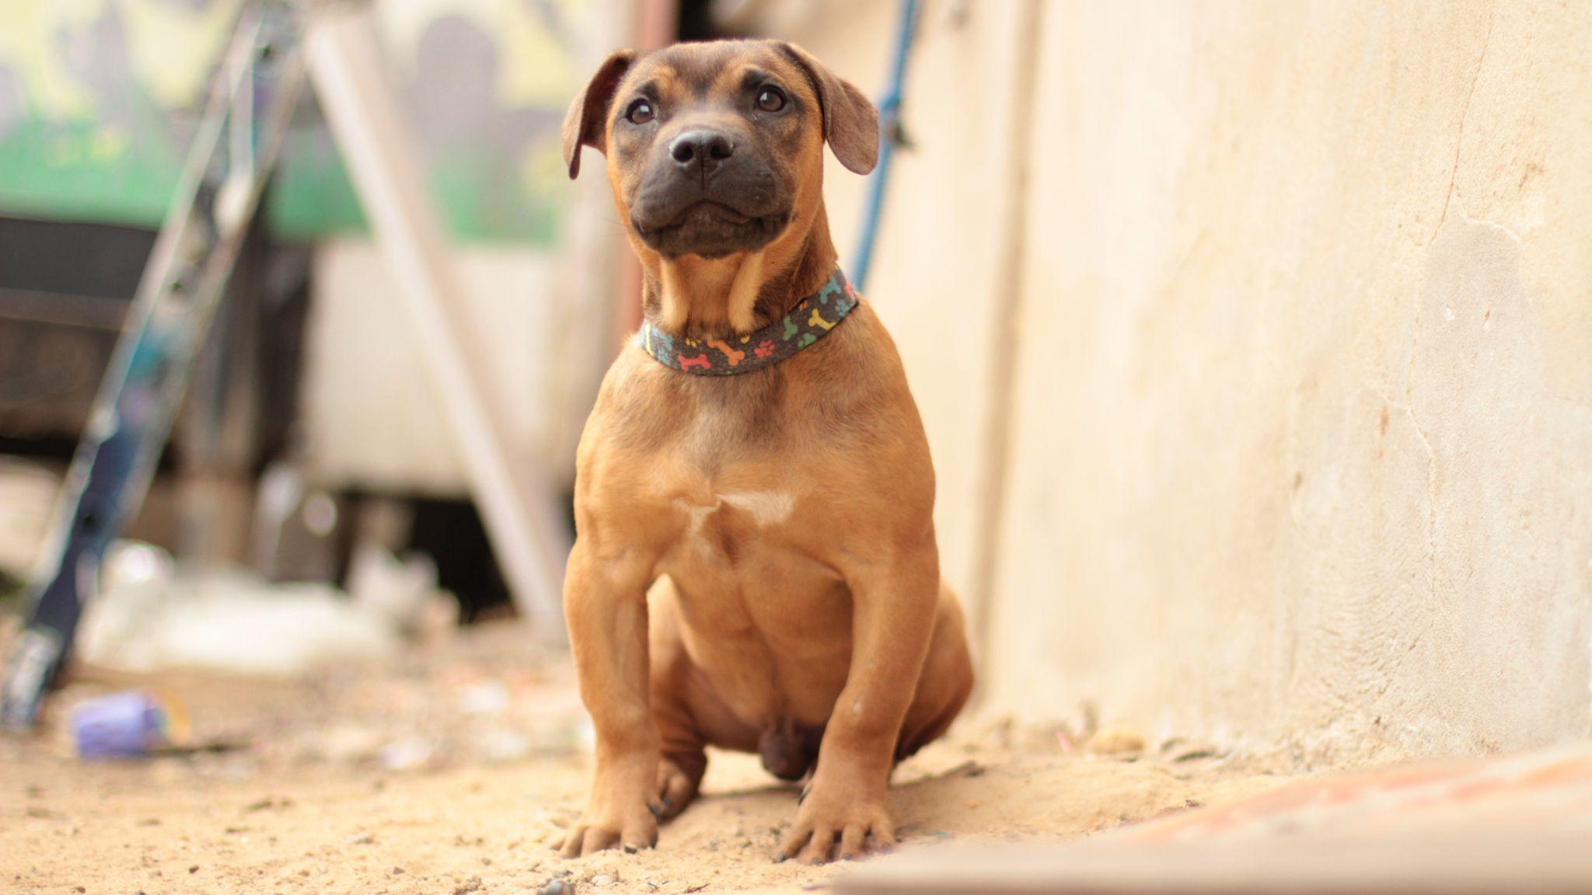
4 – Results | Regression recycling

Slide 39
4 – Results | Regression recycling
57% lives with animals (ECA, 2021)
48% consider animals “sensitive life beings with emotions” (ECA, 2021)

Slide 40
Thanks!

